Slide 1



Chapter
3
Probability
© 2012 Pearson Education, Inc.
All rights reserved.
<number> of 88

Slide 2
Chapter Outline
3.1 Basic Concepts of Probability
© 2012 Pearson Education, Inc. All rights reserved.
<number> of 88

Slide 3
Section 3.1
Basic Concepts of Probability
© 2012 Pearson Education, Inc. All rights reserved.
<number> of 88

Slide 4
Section 3.1 Objectives
Identify the sample space of a probability experiment
Identify simple events
Use the Fundamental Counting Principle
Distinguish among classical probability, empirical probability, and subjective probability
Determine the probability of the complement of an event
Use a tree diagram and the Fundamental Counting Principle to find probabilities
© 2012 Pearson Education, Inc. All rights reserved.
<number> of 88

Slide 5
Probability Experiments
Probability experiment
An action, or trial, through which specific results (counts, measurements, or responses) are obtained.
Outcome
The result of a single trial in a probability experiment.
Sample Space
The set of all possible outcomes of a probability experiment.
Event
Consists of one or more outcomes and is a subset of the sample space.
© 2012 Pearson Education, Inc. All rights reserved.
<number> of 88

Slide 6

Probability Experiments
Probability experiment: Roll a die
Outcome: {3}
Sample space: {1, 2, 3, 4, 5, 6}
Event: {Die is even}={2, 4, 6}
© 2012 Pearson Education, Inc. All rights reserved.
<number> of 88

Slide 7


Example: Identifying the Sample Space
A probability experiment consists of tossing a coin and then rolling a six-sided die. Describe the sample space.
Solution:
There are two possible outcomes when tossing a coin: a head (H) or a tail (T). For each of these, there are six possible outcomes when rolling a die: 1, 2, 3, 4, 5, or 6. One way to list outcomes for actions occurring in a sequence is to use a tree diagram.
© 2012 Pearson Education, Inc. All rights reserved.
<number> of 88

Slide 8
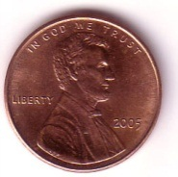
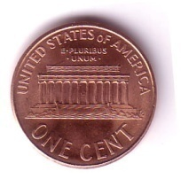









Solution: Identifying the Sample Space
Tree diagram:
H1 H2 H3 H4 H5 H6
T1 T2 T3 T4 T5 T6
The sample space has 12 outcomes:
{H1, H2, H3, H4, H5, H6, T1, T2, T3, T4, T5, T6}
© 2012 Pearson Education, Inc. All rights reserved.
<number> of 88

Slide 9
Simple Events
Simple event
An event that consists of a single outcome.
  e.g. “Tossing heads and rolling a 3” {H3}
An event that consists of more than one outcome is not a simple event.
  e.g. “Tossing heads and rolling an even number” {H2, H4, H6}
© 2012 Pearson Education, Inc. All rights reserved.
<number> of 88

Slide 10



Example: Identifying Simple Events
Determine whether the event is simple or not.
You roll a six-sided die. Event B is rolling at least a 4.
Solution:
Not simple (event B has three outcomes: rolling a 4, a 5, or a 6)
© 2012 Pearson Education, Inc. All rights reserved.
<number> of 88

Slide 11
Fundamental Counting Principle
Fundamental Counting Principle
If one event can occur in m ways and a second event can occur in n ways, the number of ways the two events can occur in sequence is m•n.
Can be extended for any number of events occurring in sequence.
© 2012 Pearson Education, Inc. All rights reserved.
<number> of 88

Slide 12

Example: Fundamental Counting Principle
You are purchasing a new car. The possible manufacturers, car sizes, and colors are listed.
  Manufacturer: Ford, GM, Honda
  Car size: compact, midsize
  Color: white (W), red (R), black (B), green (G)
How many different ways can you select one manufacturer, one car size, and one color? Use a tree diagram to check your result.
© 2012 Pearson Education, Inc. All rights reserved.
<number> of 88

Slide 13
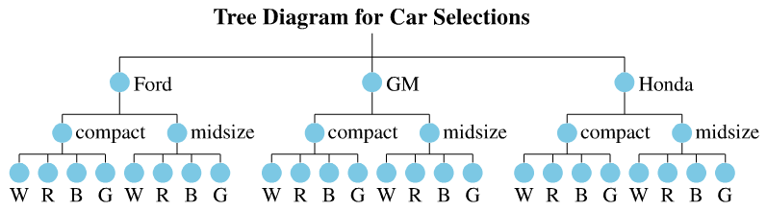
Solution: Fundamental Counting Principle
There are three choices of manufacturers, two car sizes, and four colors.
Using the Fundamental Counting Principle:
3 ∙ 2 ∙ 4 = 24 ways
© 2012 Pearson Education, Inc. All rights reserved.
<number> of 88

Slide 14
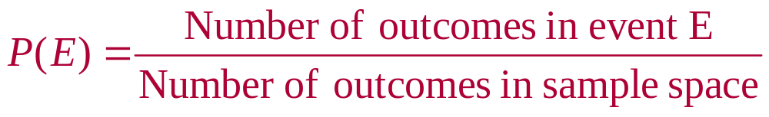
Types of Probability
Classical (theoretical) Probability
Each outcome in a sample space is equally likely.
© 2012 Pearson Education, Inc. All rights reserved.
<number> of 88

Slide 15



Example: Finding Classical Probabilities
You roll a six-sided die. Find the probability of each event.
Event A: rolling a 3
Event B: rolling a 7
Event C: rolling a number less than 5
Solution:
Sample space: {1, 2, 3, 4, 5, 6}
© 2012 Pearson Education, Inc. All rights reserved.
<number> of 88

Slide 16
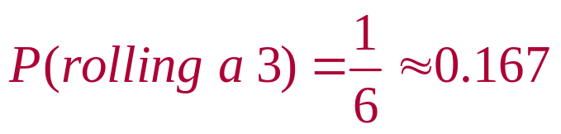
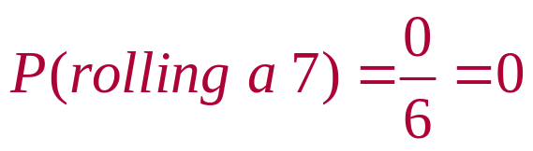
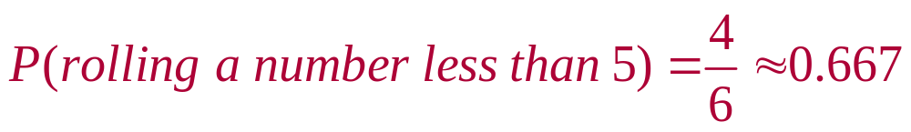
Solution: Finding Classical Probabilities
Event A: rolling a 3 Event A = {3}
Event B: rolling a 7 Event B= { } (7 is not in
the sample space)
Event C: rolling a number less than 5
Event C = {1, 2, 3, 4}
© 2012 Pearson Education, Inc. All rights reserved.
<number> of 88

Slide 17
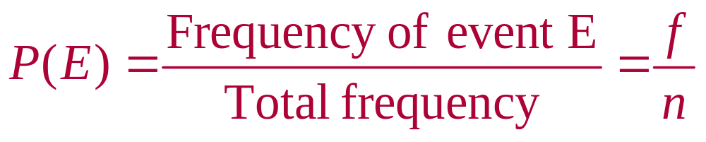
Types of Probability
Empirical (statistical) Probability
Based on observations obtained from probability experiments.
Relative frequency of an event.
© 2012 Pearson Education, Inc. All rights reserved.
<number> of 88

Slide 18
Example: Finding Empirical Probabilities
A company is conducting a telephone survey of randomly selected individuals to get their overall impressions of the past decade (2000s). So far, 1504 people have been surveyed. What is the probability that the next person surveyed has a positive overall impression of the 2000s? (Source: Princeton Survey Research Associates International)
Response | Number of times, f
Positive | 406
Negative | 752
Neither | 316
Don’t know | 30
 | Σf = 1504
© 2012 Pearson Education, Inc. All rights reserved.
<number> of 88

Slide 19
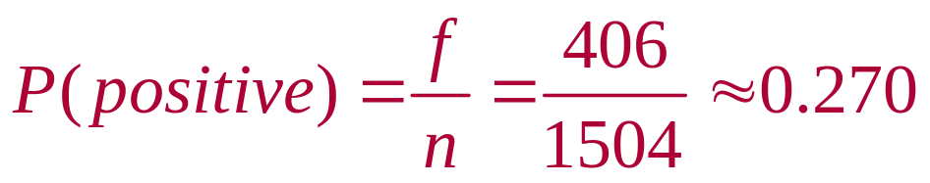
Solution: Finding Empirical Probabilities
Response | Number of times, f
Positive | 406
Negative | 752
Neither | 316
Don’t know | 30
 | Σf = 320
event
frequency
© 2012 Pearson Education, Inc. All rights reserved.
<number> of 88

Slide 20
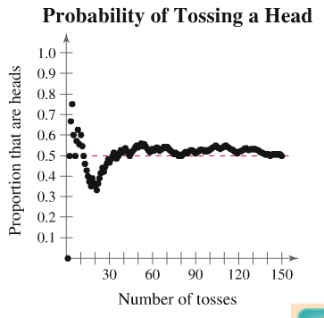
Law of Large Numbers
Law of Large Numbers
As an experiment is repeated over and over, the empirical probability of an event approaches the theoretical (actual) probability of the event.
© 2012 Pearson Education, Inc. All rights reserved.
<number> of 88

Slide 21

Types of Probability
Subjective Probability
Intuition, educated guesses, and estimates.
e.g. A doctor may feel a patient has a 90% chance of a full recovery.
© 2012 Pearson Education, Inc. All rights reserved.
<number> of 88

Slide 22
Example: Classifying Types of Probability
Classify the statement as an example of classical, empirical, or subjective probability.
The probability that you will get the flu this year is 0.1.
Solution:
Subjective probability (most likely an educated guess)
© 2012 Pearson Education, Inc. All rights reserved.
<number> of 88

Slide 23

Example: Classifying Types of Probability
Classify the statement as an example of classical, empirical, or subjective probability.
The probability that a voter chosen at random will be younger than 35 years old is 0.3.
Solution:
Empirical probability (most likely based on a survey)
© 2012 Pearson Education, Inc. All rights reserved.
<number> of 88

Slide 24


Example: Classifying Types of Probability
Classify the statement as an example of classical, empirical, or subjective probability.
The probability of winning a 1000-ticket raffle with one ticket is .
Solution:
Classical probability (equally likely outcomes)
© 2012 Pearson Education, Inc. All rights reserved.
<number> of 88

Slide 25
Range of Probabilities Rule
Range of probabilities rule
The probability of an event E is between 0 and 1, inclusive.
0 ≤ P(E) ≤ 1
Even
chance
Impossible
Unlikely
Likely
Certain
[
]
0
0.5
1
© 2012 Pearson Education, Inc. All rights reserved.
<number> of 88

Slide 26
Complementary Events
Complement of event E
The set of all outcomes in a sample space that are not included in event E.
Denoted E ′ (E prime)
P(E) + P(E ′) = 1
P(E) = 1 – P(E ′)
P(E ′) = 1 – P(E)
E′
E
© 2012 Pearson Education, Inc. All rights reserved.
<number> of 88

Slide 27
Example: Probability of the Complement of an Event
You survey a sample of 1000 employees at a company and record the age of each. Find the probability of randomly choosing an employee who is not between 25 and 34 years old.
Employee ages | Frequency, f
15 to 24 | 54
25 to 34 | 366
35 to 44 | 233
45 to 54 | 180
55 to 64 | 125
65 and over | 42
 | Σf = 1000
© 2012 Pearson Education, Inc. All rights reserved.
<number> of 88

Slide 28
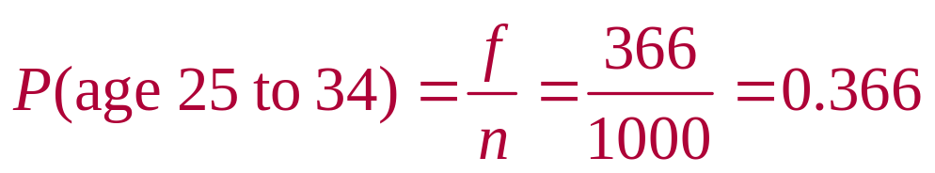
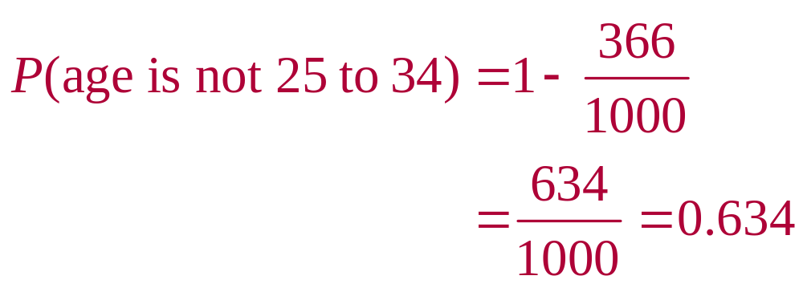
Solution: Probability of the Complement of an Event
Use empirical probability to find P(age 25 to 34)
Employee ages | Frequency, f
15 to 24 | 54
25 to 34 | 366
35 to 44 | 233
45 to 54 | 180
55 to 64 | 125
65 and over | 42
 | Σf = 1000
Use the complement rule
© 2012 Pearson Education, Inc. All rights reserved.
<number> of 88

Slide 29
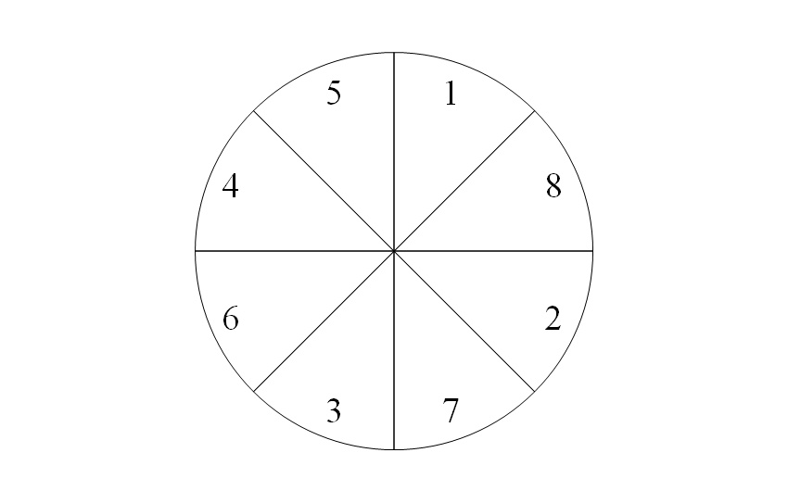
Example: Probability Using a Tree Diagram
A probability experiment consists of tossing a coin and spinning the spinner shown. The spinner is equally likely to land on each number. Use a tree diagram to find the probability of tossing a tail and spinning an odd number.
© 2012 Pearson Education, Inc. All rights reserved.
<number> of 88

Slide 30
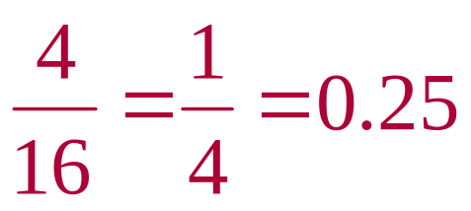
Solution: Probability Using a Tree Diagram
Tree Diagram:
H
T
1
2
3
4
5
6
7
8
1
2
3
4
5
6
7
8
H1
H2
H3
H4
H5
H6
H7
H8
T1
T2
T3
T4
T5
T6
T7
T8
P(tossing a tail and spinning an odd number) =
© 2012 Pearson Education, Inc. All rights reserved.
<number> of 88

Slide 31

Example: Probability Using the Fundamental Counting Principle
Your college identification number consists of 8 digits. Each digit can be 0 through 9 and each digit can be repeated. What is the probability of getting your college identification number when randomly generating eight digits?
© 2012 Pearson Education, Inc. All rights reserved.
<number> of 88

Slide 32
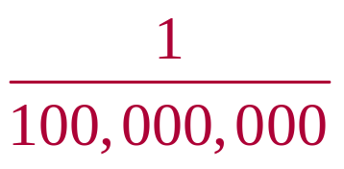
Solution: Probability Using the Fundamental Counting Principle
Each digit can be repeated
There are 10 choices for each of the 8 digits
Using the Fundamental Counting Principle, there are
  10 ∙ 10 ∙ 10 ∙ 10 ∙ 10 ∙ 10 ∙ 10 ∙ 10
  = 10⁸ = 100,000,000 possible identification numbers
Only one of those numbers corresponds to your ID number
P(your ID number) =
© 2012 Pearson Education, Inc. All rights reserved.
<number> of 88

Slide 33
Section 3.1 Summary
Identified the sample space of a probability experiment
Identified simple events
Used the Fundamental Counting Principle
Distinguished among classical probability, empirical probability, and subjective probability
Determined the probability of the complement of an event
Used a tree diagram and the Fundamental Counting Principle to find probabilities
© 2012 Pearson Education, Inc. All rights reserved.
<number> of 88

